Slide 1

Welcome to
Systems Engineering (TISYE1-U01)
First part of ”Systems Engineering og Hardware-software Co-design” (2010545 Fagpakken)
Instructor: Rune Jacobsen (rhj@iha.dk, 8730 2536)
Course home page on Campusnet (TISYE1 E10)
<number> | 2010

Slide 2
Course introduction
Systems Engineering the INCOSE way
Course outline
Literature
<number> | 2010

Slide 3

Systems Engineering the INCOSE way
“Systems Engineering is an interdisciplinary approach and means to enable the realization of successful systems. It focuses on defining customer needs and required functionality early in the development cycle, documenting requirements, then proceeding with design synthesis and system validation while considering the complete problem.”
“The INCOSE handbook defines the discipline and practice of systems engineering (SE) for student and practicing professional alike.”
<number> | 2010
Notes:
The International Council on Systems Engineering (INCOSE) is a not-for-profit membership organization founded to develop and disseminate the interdisciplinary principles and practices that enable the realization of successful systems.
Mission: Share, promote and advance the best of systems engineering from across the globe for the benefit of humanity and the planet.
Vision: The world's authority on Systems Engineering.

Slide 4
Course outline
<number> | 2010

Slide 5
Learning objectives
To acquire a theoretical foundation to handle the challenges at the system level and learn to apply this knowledge to solve specific tasks by working with one or more cases.
Specifically, the student must be able to:
Analyze complex systems
Analyze and reflect on customers and users' needs and requirements
Account for domain-specific issues
Develop plans for the development of systems
Applying theory-based methods for solving tasks
Analyze and evaluate problems and solution methods outside their own core discipline
Communicate analysis and proposed solution methods clearly and unambiguously
From Course description
<number> | 2010

Slide 6
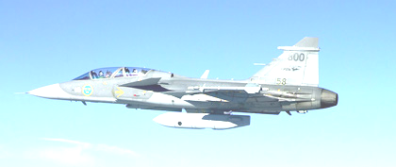

Defense and Disaster area theme
Systems Engineering concepts, methods and processes applied to the defense and disaster domain.
Totalforsvarsregion
Midtjylland
<number> | 2010

Slide 7
Lecture plan overview
Day 1: 3/9 | Day 2: 24/9 | Day 3 15/10
Introduction to the course and to Systems Engineering in General Technical processes of Systems Engineering Project management and project processes Introduction to case work Mission critical interactions designs and user experience | Totalforsvaret i Danmark (This part is in Danish) Systems Engineering at Terma | Systems design with System Modeling Language (SysML) Agreement Processes Organizational Project-Enabling Processes Specialty Engineering Activities Process tailoring Case presentations
Chapter 1-5 + papers | Papers (TBD) | Chapter 6-9
<number> | 2010

Slide 8
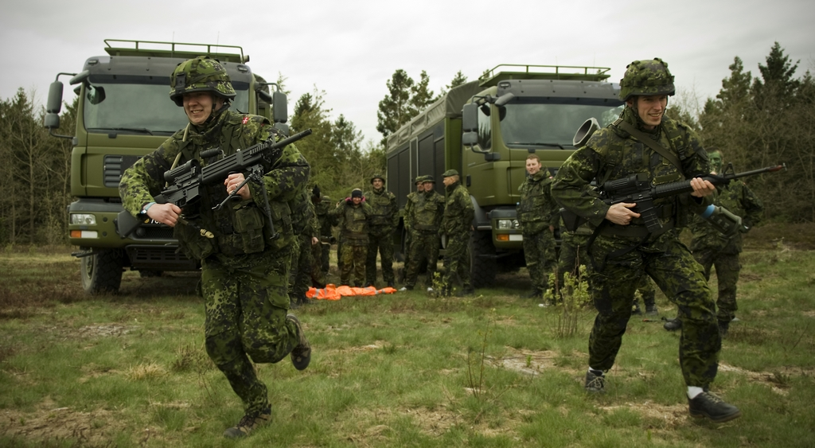
Excursion with Totalforsvarsregionen Midtjylland
Time and place: October 1st - 2nd, 2010
Prepare to bring foot wear for strenuous outdoor activity
Participation is optional.
From IHA nyhedsarkiv
<number> | 2010

Slide 9
Case work and examination
Working with two cases from Terma and Systematic respectively
Working in groups of 6-8 persons
Assuming roles as both the prime contractor and a supplier
Deliverables: Relevant systems documentation
Group presents their cases the last course day (15 min. + 5 min. for questions and answers)
Individual oral examination (week 43) based on case work resulting in a passed/not passed grade
<number> | 2010

Slide 10
Literature
Primary reading
INCOSE Systems Engineering Handbook v3.2, INCOSE-TP-2003-002-03.2, January 2010
Supplementary reading
Karl Wiegers, Writing Good Requirements. Published in Software Development Magazine, May 1999, (Available on the internet)
Ivy Hooks, Writing Good Requirements (A Requirements Working Group Information Report), Published in Proceedings of the Third International Symposium of the INCOSE, Volume 3, 1993 (Available on the Internet)
Forsberg and Mooz, System Engineering for Faster, Cheaper, Better, INCOSE 1998
Laurent Balmelli, An Overview of the Systems Modeling Language for Products and Systems Development, Journal of Object Technology, vol. 6, no. 6, 2007, pp. 149-177.
…
<number> | 2010

